Slide 1
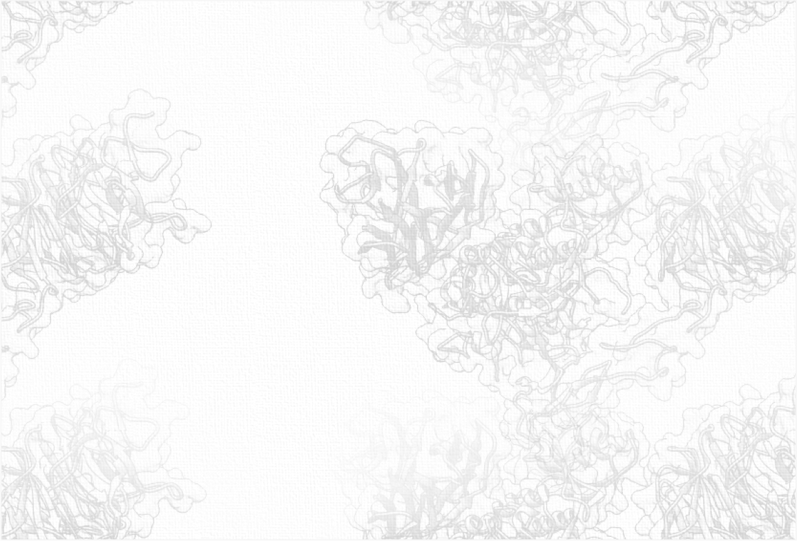
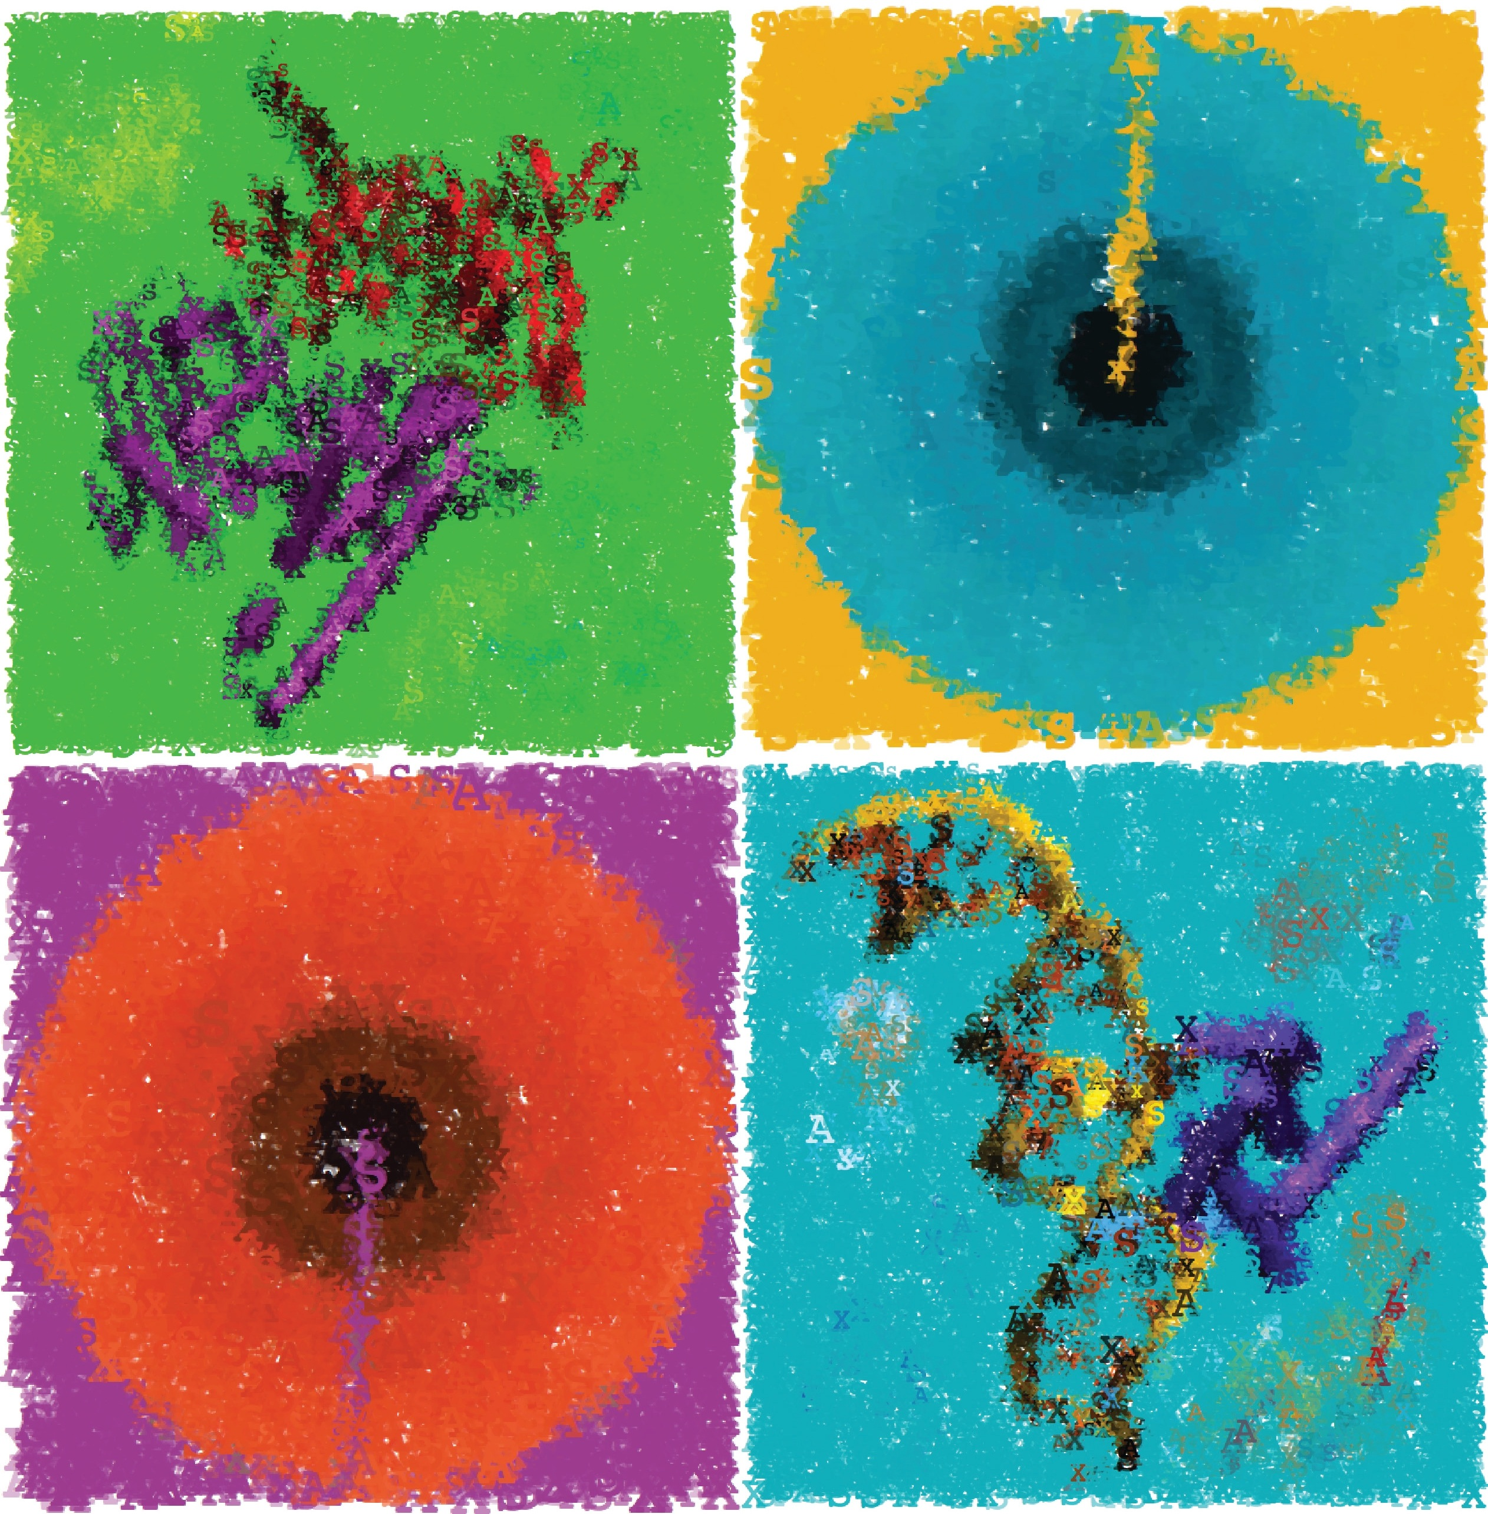
3D Data Processing in Structural Biology Lecture 11
Distance restraints

Slide 2
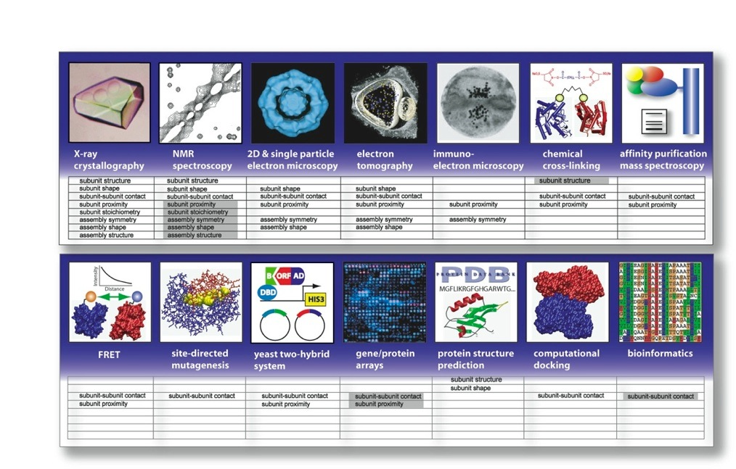
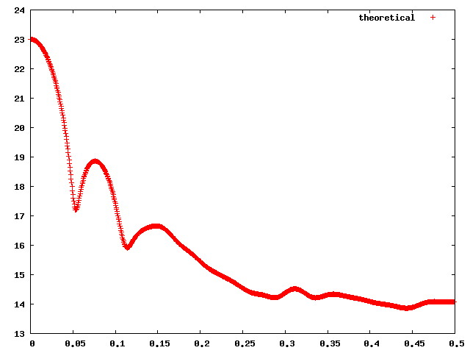
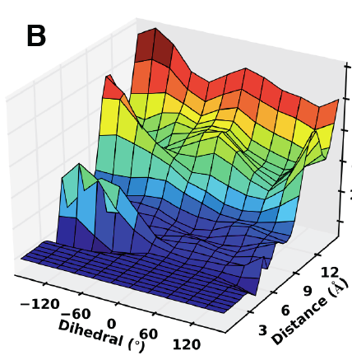
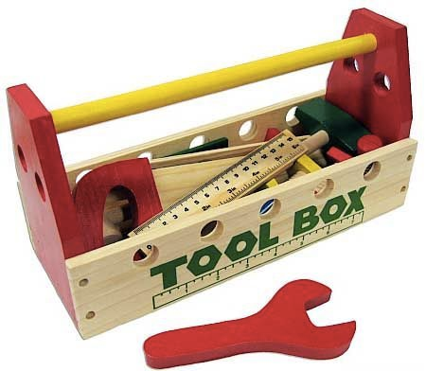
Experimental Data
X-ray
crystallography
NMR spectroscopy
electron microscopy
crosslinking
FRET
SAXS/SANS
site-directed
mutagenesis
affinity
purification
yeast
two-hybrid
bioinformatics
structure
prediction
statistical potential
Ward A, Sali A, Wilson I. Integrative structural biology. Science 2013.
Sali A, Earnest T, Glaeser R, Baumeister W. From words to literature in structural proteomics. Nature 2003.
Notes:
What is the toolbox of Structural Biology? We rely on 50 years of X-ray crystallography, which has been very successful in structure determination. Today, the PDB (protein data bank) consists of 100,000 structures mostly solved by X-ray crystallography. The bottleneck of crystallography is protein purification and crystallization resulting in the success rate below 10%. NMR spectroscopy does not require crystallization but limited by protein size. Recently, electron microscopy has been very successful in solving larger complexes and reaching higher resolutions. But today we have a large set of other methods (experimental, bioinformatics or statistics based) that provide us with structural information. Each one of these methods is a sophisticated technology and is a field on its own. But together they provide us much more structural information, than each one on its own. This leads us to Integrative Structural Biology

Slide 3
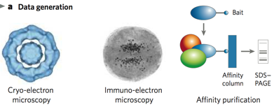
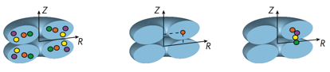
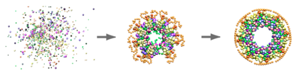
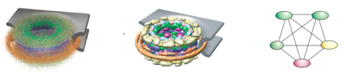
Integrative structural biology
Information
Representation & Scoring
Sampling
Analysis
Alber et al. Nature 450, 683-694, 2007
Robinson, Sali, Baumeister. Nature 450, 974-982, 2007
Russel et al. PLoS Biology 10, 2012
Notes:
and here is one way to actually put all the data together.
1. data generation, open minded about where to get it from; implicitly or indirectly informative is fine at this stage
2. representation: defines components of the system. the representation and its resolution depends on the available data (eg, point per atom; point per residue, etc). option to use a hierarchical representation is good. flexibility in representation options facilitates conversion of data into restraints.
restraints: specification of what configurations of system components are consistent with the data. needs to encode uncertainty and ambiguity ((ideally all restraints need to be satisfied within their error bars, otherwise the balance between the restraints needs to be handled, which is much more difficult)).
3. sampling: powerful optimization schemes and computers needed
4. ensemble analysis: various outcomes: 0, 1, more than 1 solution; restraints satisfied or not. precision definitely, accuracy as much as possible; feeding into the next iteration.
benefits: synergy by design, generates all (as opposed to one) models consistent with the data, facilitates assessing the models and data, allows playing what if games and planning next experiments.
involves experiment and computation rather symmetrically (steps). In fact, this is formalization of the structural biology’s virtuous scientific cycle of experiment and hypothesis, where the hypothesis corresponds to the structural model.
This should ideally be practiced almost from an outset of a project on structure characterization, not towards the end when the data are judged to be already collected.
One more comment: we’ve seen a lot of integration of data at this conference, but it seems one distinction in the case of structural biology is that there is a clear explicit model that the integration of various data is supposed to inform - and that is the structural model of the system of interest. An evocative phrase is that we are “embedding” various data in 3 dimensions.

Slide 4
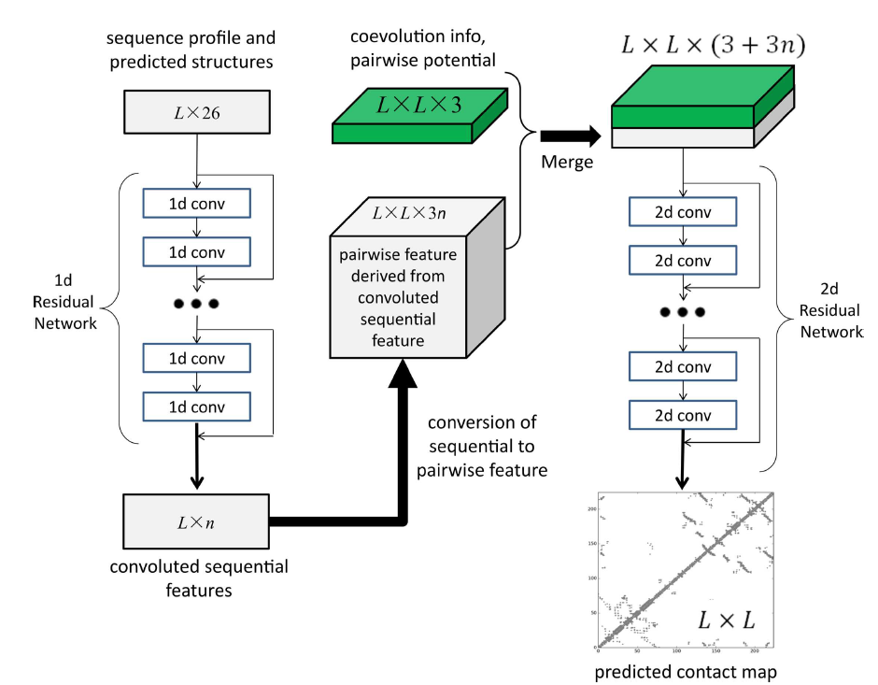
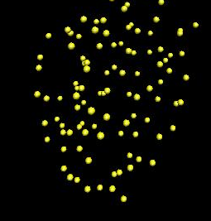
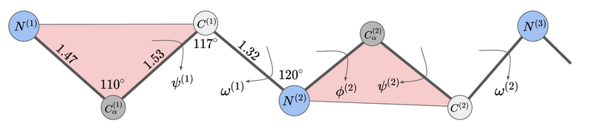
Integrative structural biology so far
Information
X-ray
crystallography
NMR spectroscopy
statistical potential
Representation
&
Scoring
Ca atoms
backbone
distogram
distance-based
angle-based
statistical potentials
Sampling
Monte Carlo
Molecular Dynamics
Analysis
Notes:
and here is one way to actually put all the data together.
1. data generation, open minded about where to get it from; implicitly or indirectly informative is fine at this stage
2. representation: defines components of the system. the representation and its resolution depends on the available data (eg, point per atom; point per residue, etc). option to use a hierarchical representation is good. flexibility in representation options facilitates conversion of data into restraints.
restraints: specification of what configurations of system components are consistent with the data. needs to encode uncertainty and ambiguity ((ideally all restraints need to be satisfied within their error bars, otherwise the balance between the restraints needs to be handled, which is much more difficult)).
3. sampling: powerful optimization schemes and computers needed
4. ensemble analysis: various outcomes: 0, 1, more than 1 solution; restraints satisfied or not. precision definitely, accuracy as much as possible; feeding into the next iteration.
benefits: synergy by design, generates all (as opposed to one) models consistent with the data, facilitates assessing the models and data, allows playing what if games and planning next experiments.
involves experiment and computation rather symmetrically (steps). In fact, this is formalization of the structural biology’s virtuous scientific cycle of experiment and hypothesis, where the hypothesis corresponds to the structural model.
This should ideally be practiced almost from an outset of a project on structure characterization, not towards the end when the data are judged to be already collected.
One more comment: we’ve seen a lot of integration of data at this conference, but it seems one distinction in the case of structural biology is that there is a clear explicit model that the integration of various data is supposed to inform - and that is the structural model of the system of interest. An evocative phrase is that we are “embedding” various data in 3 dimensions.

Slide 5
Outline
Modeling based on distance information
Sources of distance information
Scoring functions for distance information
Used in
Folding
Complex Assembly
Dynamics

Slide 6
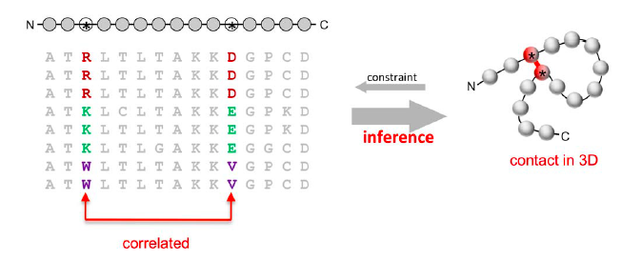
Correlated mutations from multiple sequence alignment
The evolutionary process constantly samples the space of possible sequences → structures consistent with a function
Conservation of function within a protein family imposes strong boundaries on sequence variation and generally ensures similarity of 3D structure among all family members
Residues in spatial proximity may co-evolve across a protein family to maintain energetically favorable interactions
Marks et al. PLoS ONE 2011
Notes:
In the Fast Mapping by NMR spectroscopy, each residue type is labeled separately (on N15). A single experiment will use a protein with all Arginines (for example) labeled. Next, by comparing the spectra of the selectively labeled free and complexed protein, the number of shifted amino acids of certain type can be identified.

Slide 7
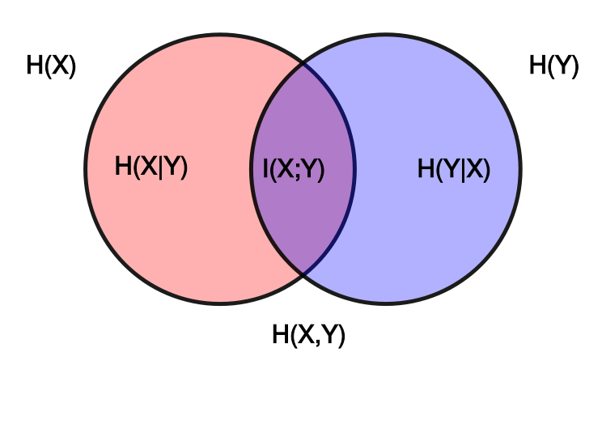
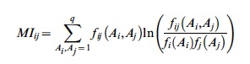
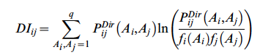
Mutual Information vs. Global Entropy
Mutual information
Direct
information
“The crucial difference between the direct information DI_{ij} and the mutual information Mi_{ij} is to replace pair probabilities estimated based on local frequency counts f_{ij}(A_{i},A_{j}), by the doubly constrained pair probabilities P_{ij}^{Dir}(A_{i},A_{j}), which are globally consistent over all pairs i,j.”
Marks et al. PLoS ONE 2011
Notes:
In the Fast Mapping by NMR spectroscopy, each residue type is labeled separately (on N15). A single experiment will use a protein with all Arginines (for example) labeled. Next, by comparing the spectra of the selectively labeled free and complexed protein, the number of shifted amino acids of certain type can be identified.

Slide 8
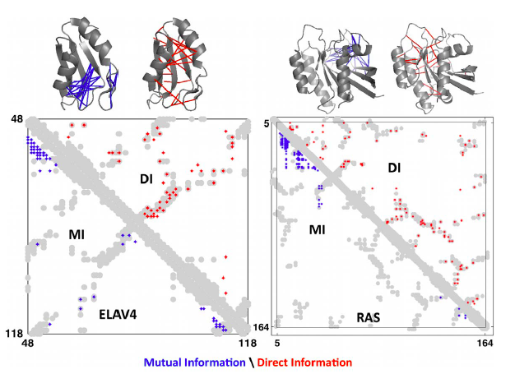
Mutual Information vs. Global Entropy
Marks et al. PLoS ONE 2011
Notes:
Progress in contact prediction using the maximum entropy method. Extraction of evolutionary information about residue
coupling and predicted contacts from multiple sequence alignments works much better using the global statistical model (right, Direct Information,
DI, Equation 3) than the local statistical model (left, Mutual Information, MI, Equation 1). Predicted contacts for DI (red lines connecting the residues predicted to be coupled from sequence information) are better positioned in the experimentally observed structure (grey ribbon diagram), than those for MI (left, blue lines), shown here for the RAS protein (upper) and ELAV4 protein (lower). The DI residue pairs are also more evenly distributed along the chain and overlap more accurately with the contacts in the observed structure (red stars [predicted, grey circles [observed] in contact map; center, upper right triangle) than those using MI (blue [predicted], grey circles [observed]; center, lower left triangle).

Slide 9
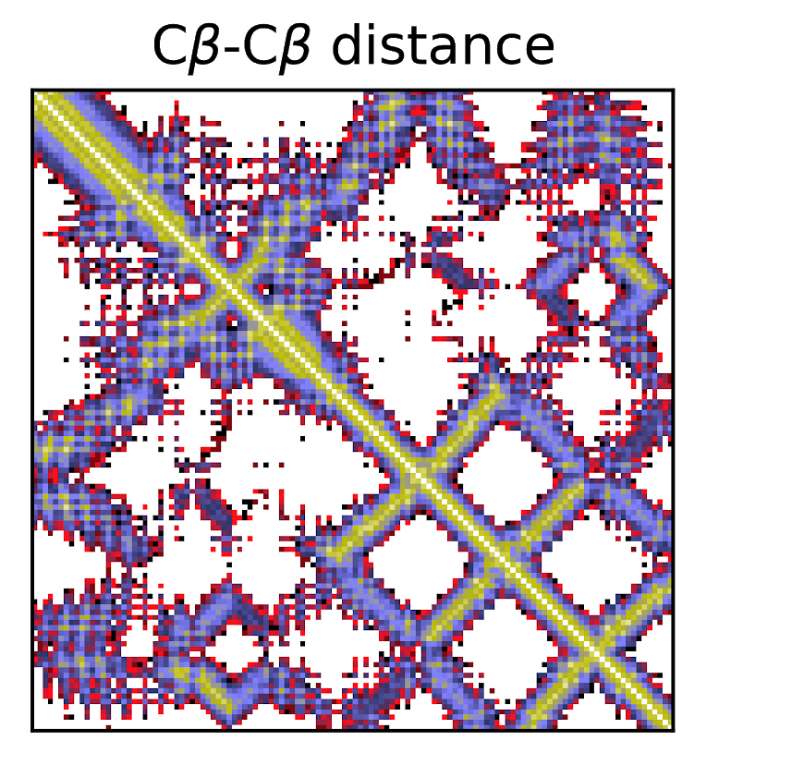
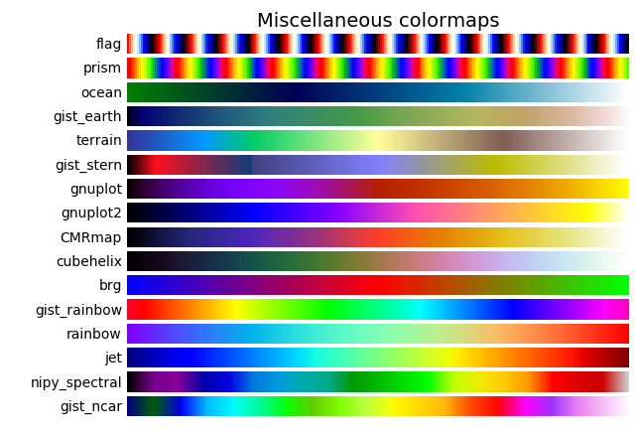
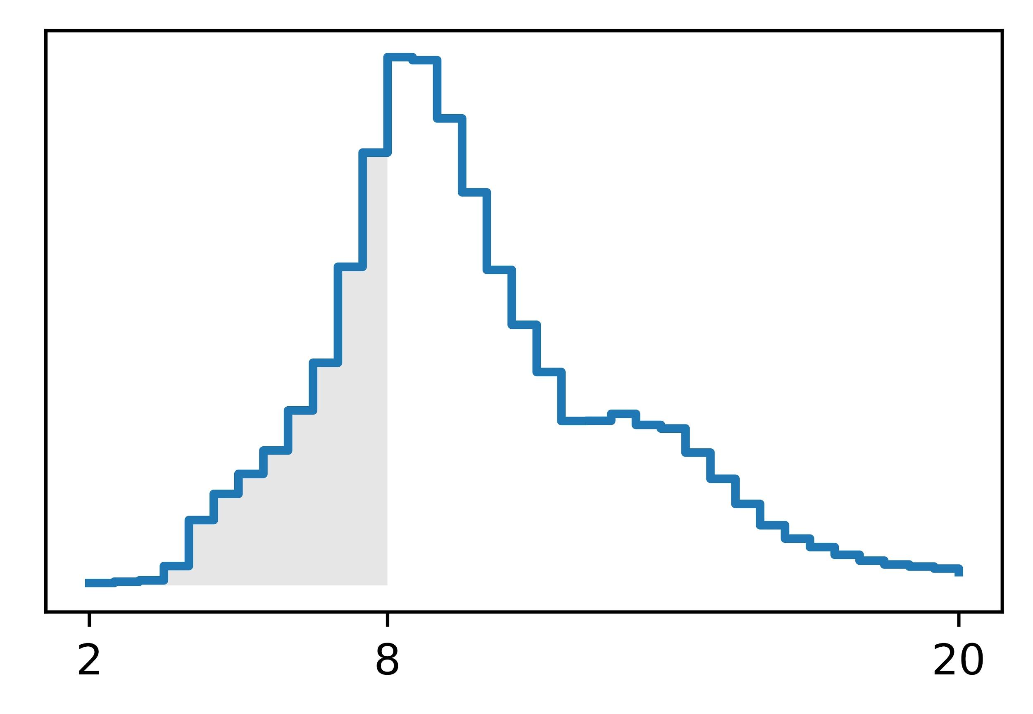
Deep Learning
20Å
2Å
probability
distance, Å

Slide 10
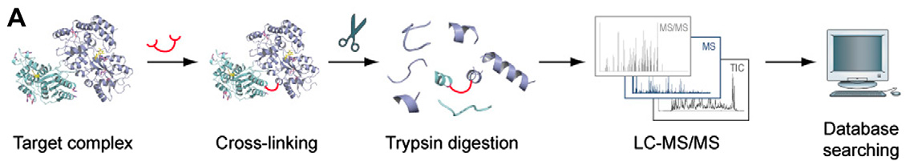
Cross-linking by Mass Spectroscopy
Determines the identity of residues that were cross-linked by a specific linker
The reactive groups usually target primary amino groups found in the side chain of lysine and at the protein N-terminus
typical Ca-Ca distances < 25Å
J. Rappsilber, J Struct Biol 2011
Notes:
In the Fast Mapping by NMR spectroscopy, each residue type is labeled separately (on N15). A single experiment will use a protein with all Arginines (for example) labeled. Next, by comparing the spectra of the selectively labeled free and complexed protein, the number of shifted amino acids of certain type can be identified.

Slide 11
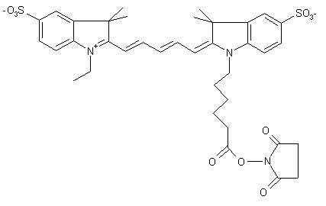
Förster Resonance Energy Transfer: FRET
FRET is a photophysical phenomenon where energy is transferred non-radiatively from a donor fluorophore to an acceptor fluorophore with the efficiency E
Organic Flurophores
Förster Equation for FRET efficiency:
Donor
Acceptor
R
YVO₄:Eu
Cy5
15 – 100 Å
R₀ is the distance at which 50% energy transfer takes place (~2–6nm).
Absorption
Emission
Absorption
Emission
466 nm
617 nm
E
617 nm
670 nm
E

Slide 12
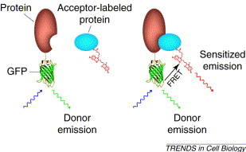
Förster Resonance Energy Transfer: FRET
Wouters 2001

Slide 13
Distance Information Summary
 | Cross links | Covariation | Deep Learning | FRET
Technique | simple experiment | computational, requires thousands of sequences | computational, learns from multiple sequences and structures | experiment
Number of distances | tens to hundreds | hundreds | all | tens
Distance range | <35Å | direct contact | Any (distribution) | 15 < d < 100Å

Slide 14
How to use input data in modeling?
Information
Representation
&
Scoring
Sampling
Analysis
Notes:
and here is one way to actually put all the data together.
1. data generation, open minded about where to get it from; implicitly or indirectly informative is fine at this stage
2. representation: defines components of the system. the representation and its resolution depends on the available data (eg, point per atom; point per residue, etc). option to use a hierarchical representation is good. flexibility in representation options facilitates conversion of data into restraints.
restraints: specification of what configurations of system components are consistent with the data. needs to encode uncertainty and ambiguity ((ideally all restraints need to be satisfied within their error bars, otherwise the balance between the restraints needs to be handled, which is much more difficult)).
3. sampling: powerful optimization schemes and computers needed
4. ensemble analysis: various outcomes: 0, 1, more than 1 solution; restraints satisfied or not. precision definitely, accuracy as much as possible; feeding into the next iteration.
benefits: synergy by design, generates all (as opposed to one) models consistent with the data, facilitates assessing the models and data, allows playing what if games and planning next experiments.
involves experiment and computation rather symmetrically (steps). In fact, this is formalization of the structural biology’s virtuous scientific cycle of experiment and hypothesis, where the hypothesis corresponds to the structural model.
This should ideally be practiced almost from an outset of a project on structure characterization, not towards the end when the data are judged to be already collected.
One more comment: we’ve seen a lot of integration of data at this conference, but it seems one distinction in the case of structural biology is that there is a clear explicit model that the integration of various data is supposed to inform - and that is the structural model of the system of interest. An evocative phrase is that we are “embedding” various data in 3 dimensions.

Slide 15
How to use input data in modeling
As representation (e.g. rigid body X-ray structure)
In sampling (e.g. only propose system perturbations that are consistent with the data)
as a constraint: ensure the data are consistent
As a mathematical function that scores how closely our model (representation) matches the input data:
restraint: sample configurations guided by the value of this function
filter: build models (guided by some other function) then only keep those that score well against the filter
restraint is preferred over filter (but slower)
As validation: don’t use the data at all, until after we’ve selected the ‘best’ models

Slide 16
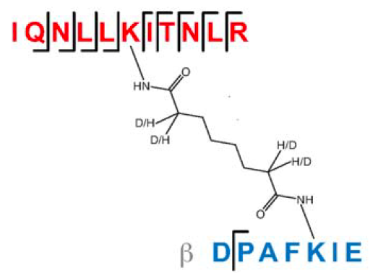
What is the measured distance?
DSS/BS3 cross-link has a length of 11.4 Å
given the length of a lysine side chain is 6.4Å (12.8 2*6.4)
maximal physical length of 24.2 Å
much longer distances between cross-linked residues are commonly observed
recent publications use a maximum-bound of 35 Å as a restraint when modeling

Slide 17
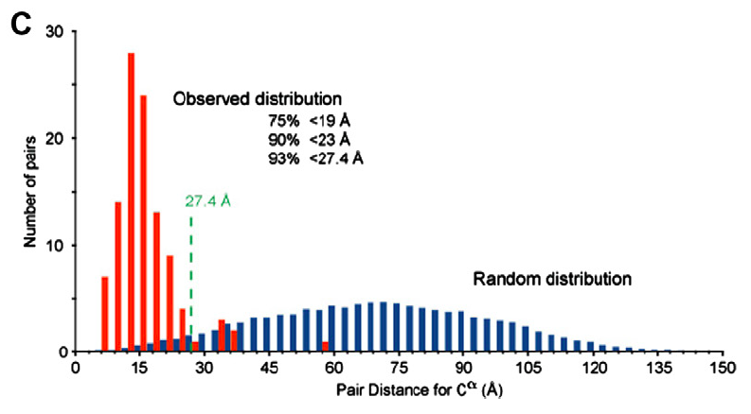
What is the measured distance?
RNA Pol II. Rappsilber. J Struct Biol 2011

Slide 18
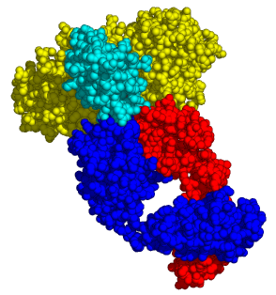
Scoring function 1: Number of violations
A list of cross linked residue pairs, average distance and standard deviation for the specific cross link
A distance for each cross-linked residue pair
cross-links are scored with either 0 or 1 depending on whether the distance between cross-linked residues is below or above the cut-off
lower score corresponds to a more near-native model
Notes:
Cross linking dataset usually has a list of cross linked lysines with mean and standard deviation for the distances observed for the specific cross link. The score uses a gaussian function to assess the fit of each distance to the expected mean.

Slide 19
Scoring function 1a: sum of violation distances
crosslinks are scored by taking the violating distance over 33 Å for each violating crosslink
These are then totaled for the model into the sum of violation distances
lower sum corresponds to a more near-native model
Notes:
Cross linking dataset usually has a list of cross linked lysines with mean and standard deviation for the distances observed for the specific cross link. The score uses a gaussian function to assess the fit of each distance to the expected mean.

Slide 20
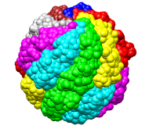
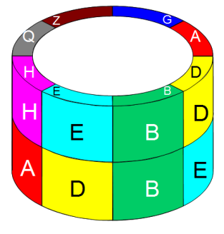
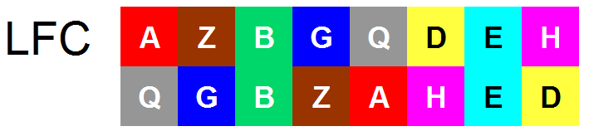
Combinatorial Homology Modeling
8! = 40,320 full 3-D models
Unbiased assessment to XL-MS data
Kalisman&Levitt

Slide 21
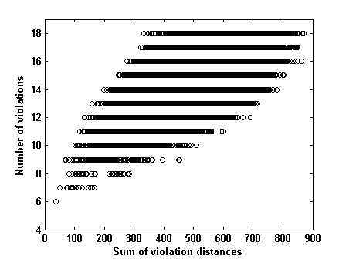
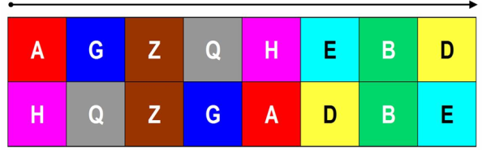
Combinatorial Homology Modeling (2)
*
[Å]
Native
arrangement

Slide 22
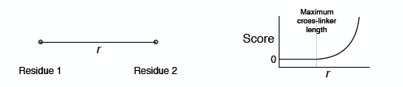
Scoring function 2: upper bound harmonic
A list of cross linked residue pairs, average distance and standard deviation for the specific cross link
A distance for each cross-linked residue pair
Simplest way to score a cross-link would be as an upper
bound harmonic on the inter-residue distance
Notes:
Cross linking dataset usually has a list of cross linked lysines with mean and standard deviation for the distances observed for the specific cross link. The score uses a gaussian function to assess the fit of each distance to the expected mean.

Slide 23
Scoring function 3: based on normal distribution
J. Rappsilber, J Struct Biol 2011
Notes:
Cross linking dataset usually has a list of cross linked lysines with mean and standard deviation for the distances observed for the specific cross link. The score uses a gaussian function to assess the fit of each distance to the expected mean.

Slide 24
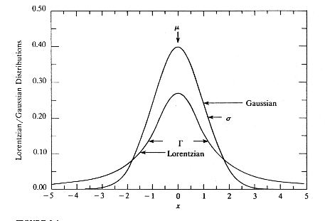
Protein folding with cross-links
cross links are converted to scoring function using Lorentz function which is smoother than Gaussian
In addition, evolutionary constraints are used based on predicted co-variation
the restraints are added to the Rosetta ab initio protocol
Belsom et al. MCP 2016

Slide 25
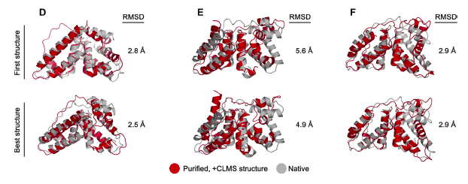
Protein folding with cross-links
Belsom et al. MCP 2016

Slide 26
Rosetta options:
https://new.rosettacommons.org/docs/latest/rosetta_basics/file_types/constraint-file#constraint-types

Slide 27
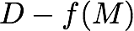
Scoring function 4: Bayesian modeling of structure(s)
M model
D data
I prior information
f(M) forward model
posterior
likelihood
prior
Posterior is the probability density of model M, given data D and information I.
Model M can include coordinates of one or more structures X as well as additional parameters (noise levels, weights, calibration parameters, ...).
Likelihood is the probability density of observing data D, given model M and prior information I (by relying on a model of noise and a forward model, which computes data D given model M).
Prior is the probability density of model M, given prior information I.
Rieping, Habeck, Nilges. Science, 2005

Slide 28
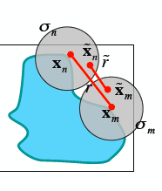
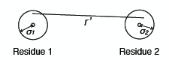
Scoring function 4: Bayesian modeling of structure(s)
M model
D data
I prior information
f(M) forward model
posterior
likelihood
prior
account for uncertainty in position by instead restraining inter-sphere distance (sphere radius, σ ≈ uncertainty)
account for confidence in the cross-links themselves with another parameter, ψ
The score is Bayesian and the σ and ψ parameters are optimized to best fit the data

Slide 29
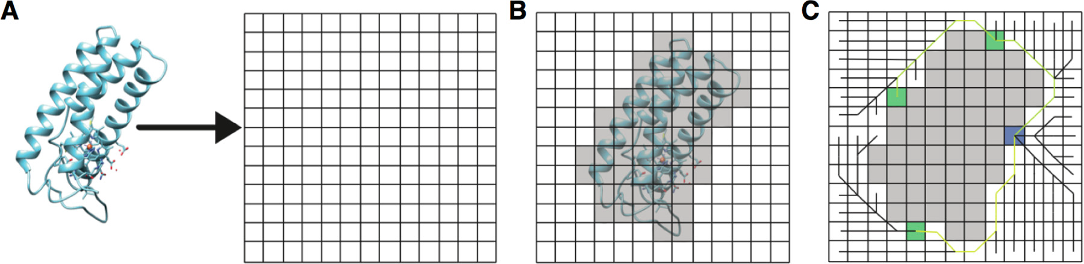
Scoring function 5: Solvent Accessible surface distance (SASD)
solvent accessible surface (SAS) is approximated by expanding a sphere around each atom in the structure except those of the lysine and N-terminal side-chains
grid voxels belonging to the protein are labeled
BFS is performed from each solvent accessible Lys to calculate distances on the surface

Slide 30
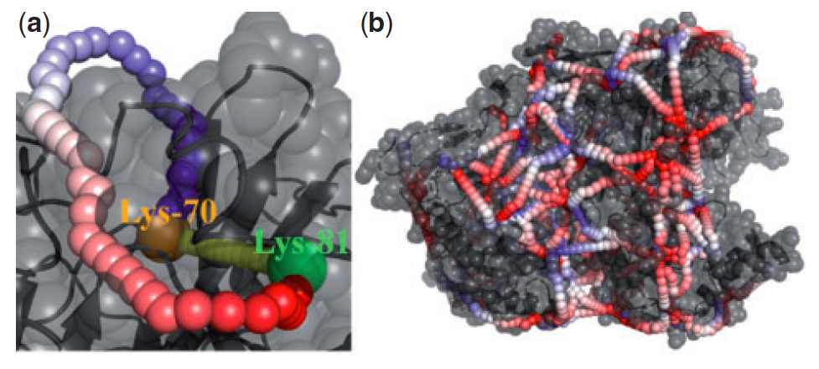
Scoring function 5: Solvent Accessible surface distance (SASD)
Xwalk: http://www.xwalk.org/
Jwalk (Bullock et al. MCP 2016)

Slide 31
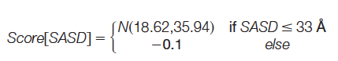
Scoring function 5a: Matched and Non-accessible Crosslink Score (MNXL)
scored positively, using a normal distribution (the mean and variance are calculated from all the SASDs 33 Å from the XLdb)
flat penalty
test for folding application
14 protein domains with experimental cross-links
300 models were generated in MODELLER for each protein
different levels of accuracy using the ‘suboptimal alignment’ function
a range of 0–30 Å RMSD
Bullock et al. MCP 2016

Slide 32
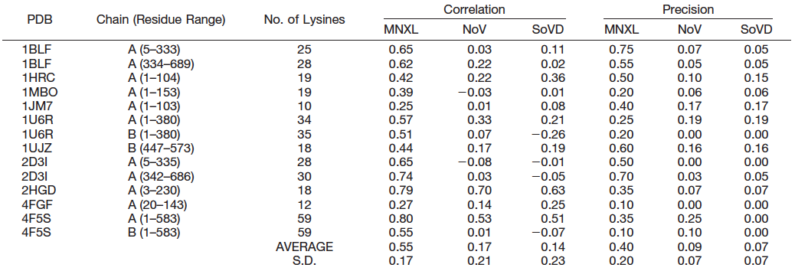
Scoring function 5a: Matched and Non-accessible Crosslink Score (MNXL)
Bullock et al. MCP 2016

Slide 33
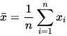
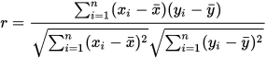
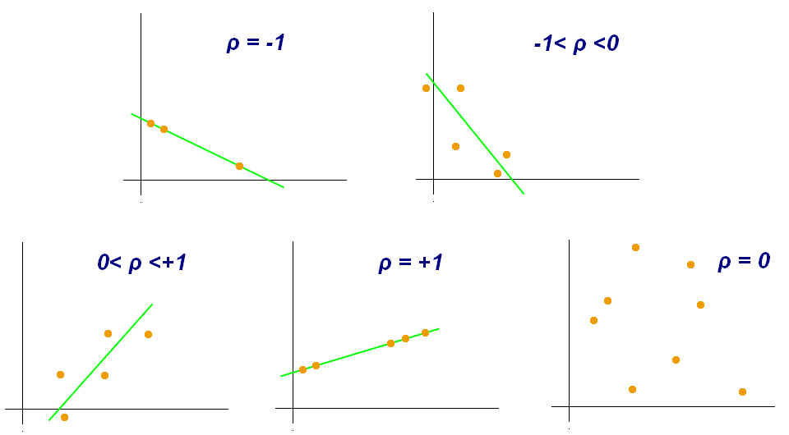
Pearson cross correlation coefficient
one dataset {x₁,...,x_{n}} containing n values and another dataset {y₁,...,y_{n}} containing n values

Slide 34
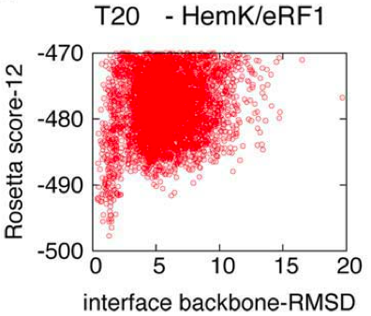
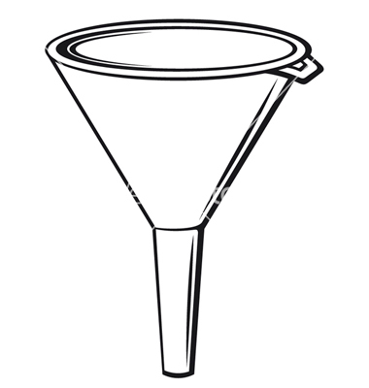
Folding/Scoring Funnel
useful scoring function should have a funnel-like shape in a RMSD-score plot:

Slide 35
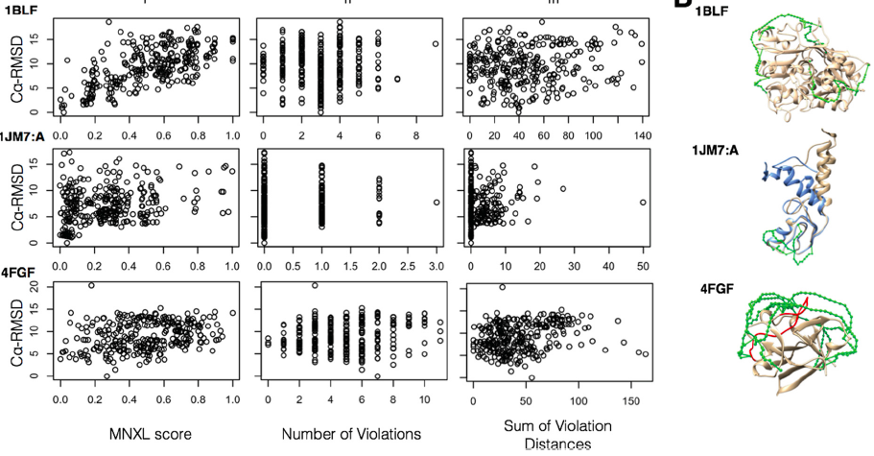
Scoring function 5a: Matched and Non-accessible Crosslink Score (MNXL)

Slide 36
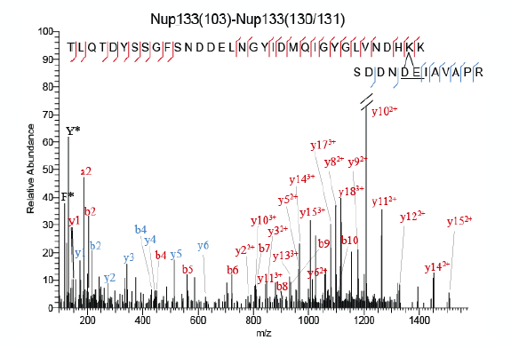
Ambiguity in cross-linking data
Cross link identification - not always possible to uniquely identify a cross-link from the spectra:

Slide 37
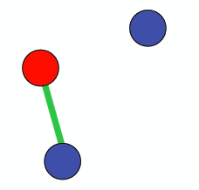
Ambiguity in cross-linking data
2. Compositional ambiguity - can also occur if there are
multiple copies of a protein available:
A cross-link observed between
the red and blue proteins does
not identify which blue protein is
interacting with red
the same ambiguity occurs with covariation data and FRET

Slide 38

Ambiguity in cross-linking data
3. State/conformation ambiguity - can occur if there are multiple states of the complex present (heterogeneity):
The cross-linking experiment will yield cross-links representative of both states
A single model cannot satisfy both cross-links simultaneously
the same ambiguity occurs with covariation data and FRET

Slide 39

Protein 3D structure computed from evolutionary sequence variation
EVfold
Marks et al. PLoS ONE 2011

Slide 40
Protein 3D structure computed from evolutionary sequence variation
Protein sequence alignment for the protein family containing the target protein
Formulation of a global statistical model for sequences in a protein family
Derivation of parameters that maximize entropy in this model, using direct coupling analysis (DCA)
Derivation of a ranked set of evolutionarily inferred contacts (EICs)
Secondary structure prediction using well-established methods
Implementation of weighted distance restraints from inferred contacts
Application of distance geometry and constrained molecular dynamics
Automated ranking of predicted structures to nominate a single predicted structure and a set of lower-ranked alternatives
Evaluation, effectively blinded, of prediction accuracy
Information
Representation
&
Scoring
Sampling
Analysis

Slide 41
From correlations to distance restraints
Primary sequence position: sequence neighbors are likely to co-vary due to the nature of the polypeptide chain. Ignore correlated pairs separated by five or fewer positions in sequence
Conservation filter: ignore correlations from highly conserved positions (>95%)
Cysteine pairs and disulfide bonds : each Cys side chain is only able to form a disulfide bond with one other Cys side chain
Harmonic restraints centered at 4Å (<7Å) are derived for Calpha atoms of the remaining correlated pairs
Secondary structure prediction: PredictProtein and PsiPred calculate the secondary structure assignments for each amino acid from the primary sequence. Predictions are used to derive local distance constraints

Slide 42

Structure sampling with distance geometry and constrained MD
Marks et al. PLoS ONE 2011

Slide 43

Protein folding examples
Marks et al. PLoS ONE 2011

Slide 44

RNA folding
Weinreb et al. Cell 2016

Slide 45
Protein folding with cross-links
need to increase the density of cross-links
use sulfo-SDA cross-linker because it is less specific in it’s reactivity than standard homobifunctional NHS-ester based cross-linkers
SDA cross-links to form between K/S/T/Y on one side and any amino acid on the other
Human Serum Albumin (HAS) protein (585 amino acids):
Standard cross-linker (BS3)→43 distance constraints
sulfo-SDA →205/500/881/1495 at 1/5/10/20% false discovery rate (FDR)
644/1304 distance constraints at 10/20% FDR in blood serum HSA
1.5/2.5 restraints per residue at 10/20% FDR
Belsom et al. MCP 2016

Slide 46


SARS-CoV-2 NSP2 protein
DeepMind published models for a few SARS-CoV-2 proteins, including nsp2
blue - satisfied crosslink
red– violated crosslink
Collaboration with Kalisman, Linial labs

Slide 47


Domain assembly problem

